Slide 1
FARMER SHOP
Name :
College :
Class :
Year :

Slide 2
ABSTRACT
India is an agro based country. The main livelihood of the majoritarian population here is through farming who dwell in villages and feed the whole country.
Food is one of the basic necessities of a human being, which is fulfilled by the framers. However, they fail to get proper price of the Food they sell in the market. Hence, they are deprived from getting profits for their Food. FARMER SHOP helps them in getting proper price for their Food and even get profit for their efforts
for the farmers in which they can get maximum pricing for their outcomes.
In this idea is FARMER SHOP Food selling in which farmers can ask for the highest price for their food to be sold and can earn profit. Also, farmers can register themselves and have various other facilities such as feedback, contact to the wholesalers, price notifications etc.

Slide 3
INTRODUCTION
The farmers who grow crops according to the season and fertility of the soil, after growing the crops they accumulate the crops, further process and pack them and contact the wholesale vendors regarding the availability of stock.
The wholesale vendor first asks the price to the farmer who tells the price at which he/she can Sell at. The wholesale vendor aiming for his own profits negotiates with the farmer regarding the price the poor framers sacrificing their profits generally accept the price quoted by the wholesale vendor.
So, he/she sell their Food at low prices due to some unfavourable conditions such as financial problems, unavailability of wholesale vendors or market etc.
Some farmers who live very near to the cities bring their Food directly to the wholesale markets and sell their Food to the retailers and end customers. But for the farmers who live in the remote areas, it is not possible for them to come to the cities do frequently and sell their Food directly in their quoted price. Hence, they have no other option but to contact the wholesale vendor for selling their products in the market.

Slide 4
INTRODUCTION
It is indeed a very long process to grow crop since there are various other conditions such as weather issues, soil infertility, seed defects etc. They expect to get some profits for many such issues they face.
The wholesale vendor after buying the stock from the farmers in their quoted price, they sell it to the retailer vendors and customers as well. The retailer vendors then sell it to the end consumer. The price changes stage to stage depending upon the negation done either earning profits or saving money.
Keeping in mind the various issues which a farmer faces such as poor financial conditions, indebtedness, etc for these problems, the farmers expects to get profit or even the price quoted at par for some or other improvement. But then he/she has to agree upon the low price quoted by the wholesale vendors due to some situation such as absence of unreachability of to the market, unavailability of other wholesale vendors etc, with expectation of some improvement though the money earned he/she bears lots as well.

Slide 5
INTRODUCTION
This happens due to the negotiation and saving mentality of the buyer. The seller quotes the high price aiming at his high profit but the buyer negotiates at low price considering their savings and due to the poor conditions of the farmers they are obliged to accept the low price from the wholesale vendors with expectation of some income. Hence, the farmers are unable to make profits.
Despite of all the hard work and patience to grow the Food, farmers play a major role in the agriculture life cycle but still they fail to get profit due to their poor conditions.

Slide 6
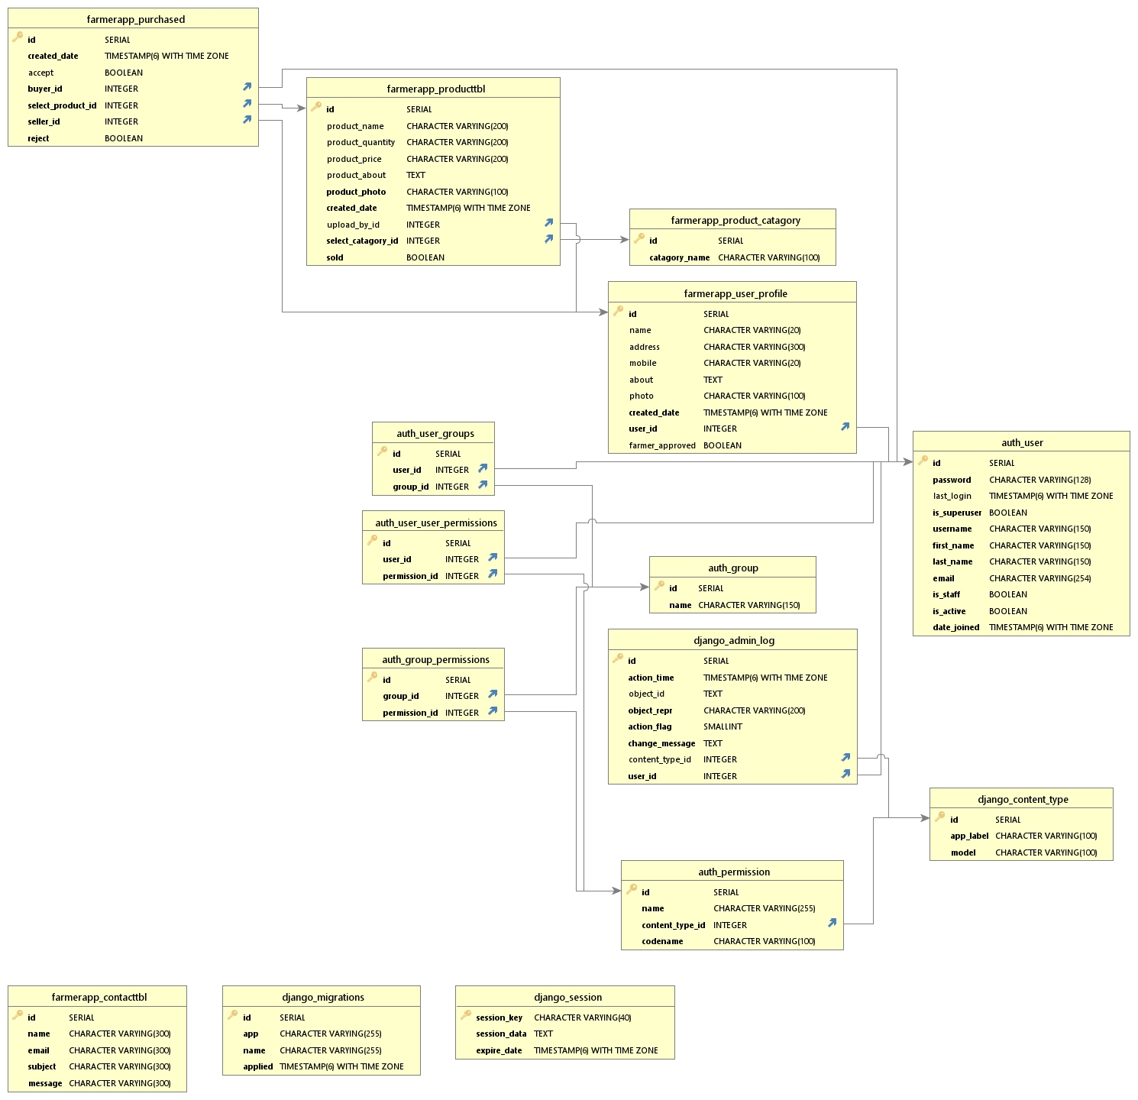
ER DIAGRAM

Slide 7
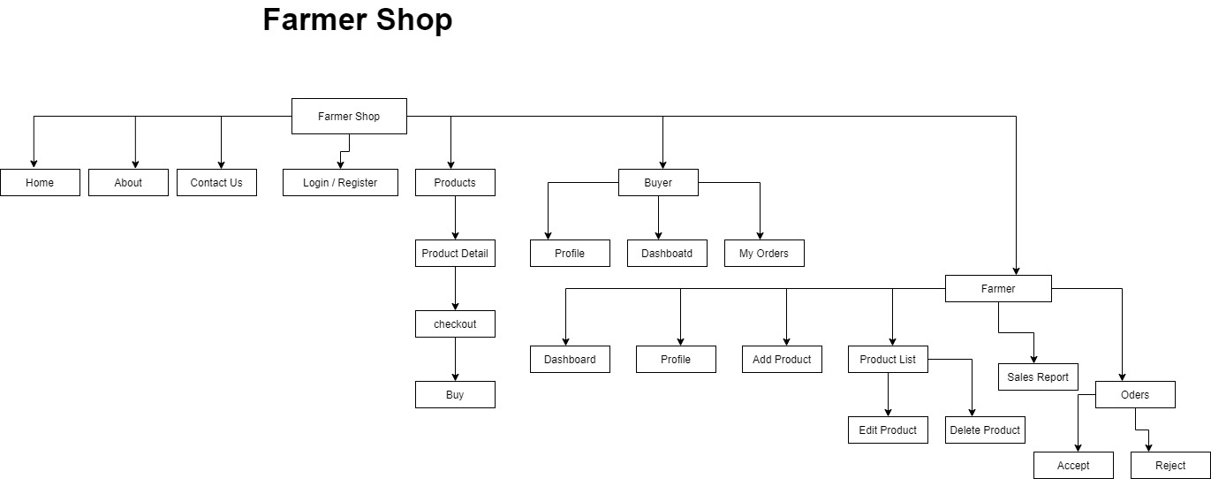
FLOW DIAGRAM

Slide 8
FRONT END / DESIGNING LANGUAGES
HTML :
HTML stands for Hyper Text Markup Language
HTML is the standard markup language for creating Web pages
HTML describes the structure of a Web page
HTML elements tell the browser how to display the content
HTML elements label pieces of content such as "this is a heading", "this is a paragraph", "this is a link", etc.
2) CSS:
CSS stands for Cascading Style Sheets
CSS describes how HTML elements are to be displayed on screen, paper, or in other media
CSS saves a lot of work. It can control the layout of multiple web pages all at once
External stylesheets are stored in CSS files

Slide 9
FRONT END / DESIGNING LANGUAGES
3) JavaScript:
JavaScript, often abbreviated as JS, is a programming language that conforms to the ECMAScript specification. JavaScript is high-level, often just-in-time compiled, and multi-paradigm. It has curly-bracket syntax, dynamic typing, prototype-based object-orientation, and first-class functions.
4 ) Bootstrap:
Bootstrap is a free front-end framework for faster and easier web development
Bootstrap includes HTML and CSS based design templates for typography, forms, buttons, tables, navigation, modals, image carousels and many other, as well as optional JavaScript plugins
Bootstrap also gives you the ability to easily create responsive designs

Slide 10
BACKEND / SERVER SIDE LANGUAGES
1) Python:
Python is a popular programming language. It was created by Guido van Rossum, and released in 1991.
It is used for: web development (server-side), software development, system scripting.
Python was designed for readability, and has some similarities to the English language with influence from mathematics.
Python relies on indentation, using whitespace, to define scope; such as the scope of loops, functions and classes. Other programming languages often use curly-brackets for this purpose.
2 ) Django:
Django is a high-level Python web framework that encourages rapid development and clean, pragmatic design. Built by experienced developers, it takes care of much of the hassle of web development, so you can focus on writing your app without needing to reinvent the wheel. It’s free and open source.

Slide 11
DATABASE
1) PostgreSQL:
PostgreSQL is a powerful, open source object-relational database system with over 30 years of active development that has earned it a strong reputation for reliability, feature robustness, and performance.
PostgreSQL comes with many feature aimed to help developers build applications, administrators to protect data integrity and build fault-tolerant environments,
help you manage your data no matter how big or small the dataset. In addition to being free and open source PostgreSQL is highly extensible.
For example, you can define your own data types, build out custom functions, even write code from different programming Languages without recompiling your database!

Slide 12
ABOUT PROJECT
The farmers who grow crops according to the season and fertility of the soil, after growing the crops they accumulate the crops, further process and pack them and contact the wholesale vendors regarding the availability of stock. The wholesale vendor first asks the price to the farmer who tells the price at which he/she can trade at. The wholesale vendor aiming for his own profits negotiates with the farmer regarding the price the poor framers sacrificing their profits generally accept the price quoted by the wholesale vendor. So, our application helps the farmer to get proper price for their food.
Basically this project is web application so this can run any platform we only need internet connection and one browser,
IN this project multiple user login first is farmer and another one is Buyer Farmer Add their food and Buyer Buy this food directly from farmer using our application.
Farmer can see his sells reports and orders if former can get multiple orders then he can reject which they don’t want to accept .
After accepting order from farmer buyer will be notified that the former accept their order and they can move further process for delivery.

Slide 13
ADVANTAGES
Anyone can see foods/products of site without registering
Store All users data and display self owned data to user.
Famer get proper price for their food
Buyer can get best food.
Access from anywhere and anytime
Farmer or Buyer can contact to administrator for help.
Customer can go through to this site without registering themselves.

Slide 14
HARDWARE REQUIREMENT
Processor : Pentium IV or Above
RAM : 512GB or above
Hard Disk : 512gb or above
Input Devices : Keyboard, Mouse
Output Devices : Monitor , mobile

Slide 15
OPERATING SYSTEM
Windows7/8/XP/10/11
Linux
Mac
Android

Slide 16
SOFTWARE USED
VS Code (Visual Studio Code Editor)
Sublime Text Editor
DB Visualizer
PgAdmin 4
Chrome Browser

Slide 17
MODULES
Main Module:
Homepage
About Page
Contact Us Page
Products
Product Detail
Login for Farmer and Buyer
Register for Farmer and Buyer (farmer account need verification)
Search Functionality
Checkout Page

Slide 18
MODULES
2) Farmer Module:
Farmer Dashboard
Profile
Add Product
Product List
Sales Report
Orders
3) Buyer Module:
Buyer Dashboard
Profile
Orders

Slide 19
MODULES
4) Main Module:
Admin Dashboard
Users (create, read, update, delete)
Messages (create, read, update, delete)
Products (create, read, update, delete)
Product Category (create, read, update, delete)
Purchased Products (create, read, update, delete)
User Profile (create, read, update, delete)

Slide 20
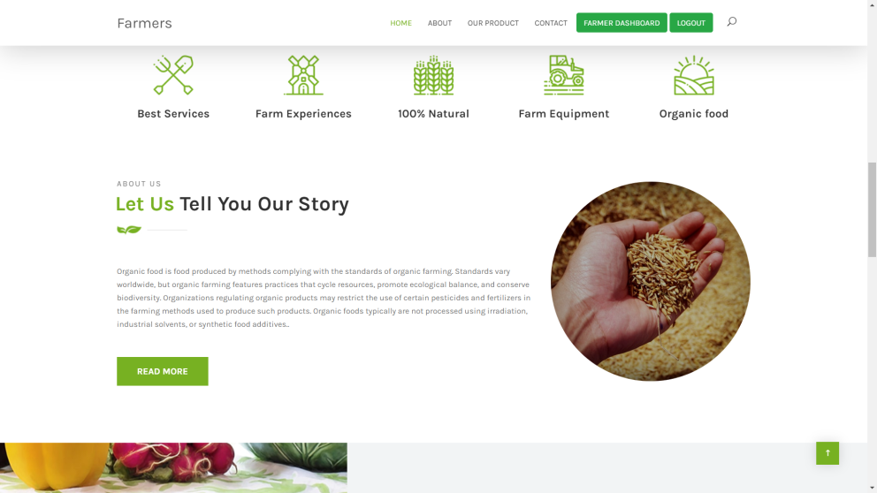
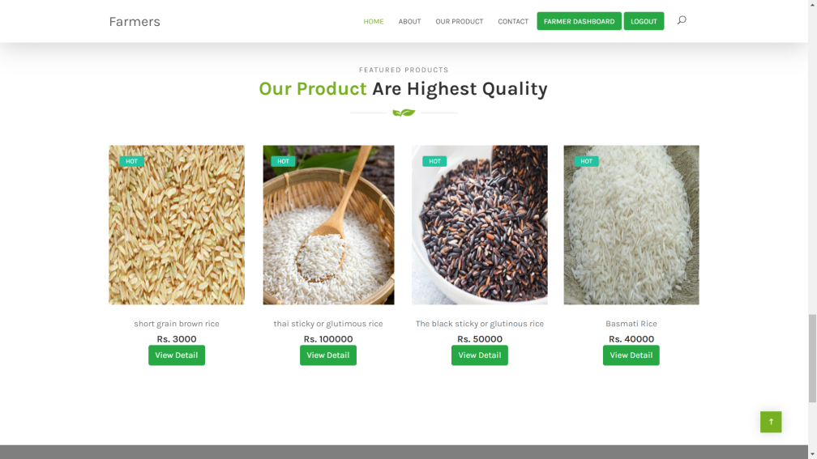
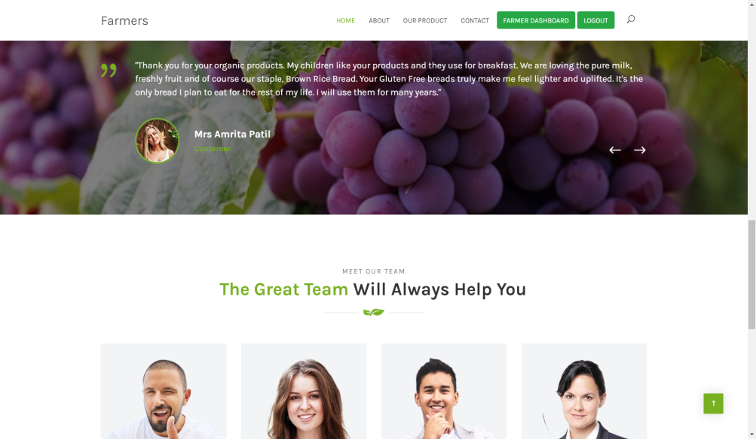
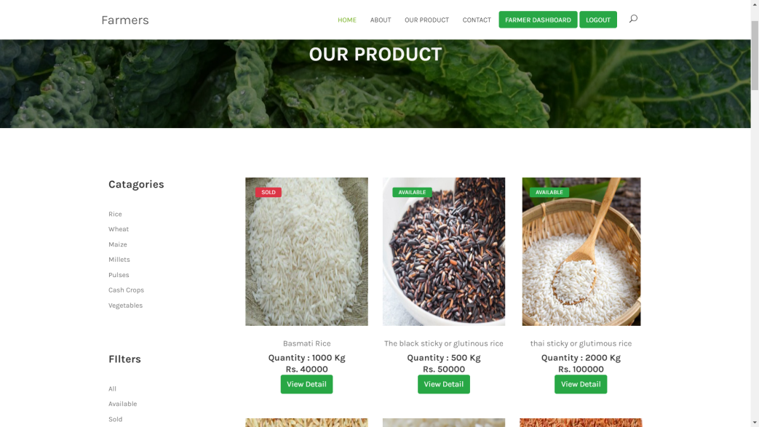
PROJECT SCREENSHOTS

